Slide 1
DEFENSE PROPOSAL
By Paul-Darius Sarmadi
21/03/2016
Committee
Dr. Matthew Dailey (Chairperson)
Dr. Mongkol Ekpanyapong Dr. Manukid Parnichkun

Slide 2
PROPOSAL
DEEP LEARNING FOR
IMAGE RECOGNITION
IN SURVEILLANCE VIDEOS

Slide 3
SUMMARY
I – Introduction
II – Literature Review
III – Methodology
IV – Preliminary Results

Slide 4
Introduction

Slide 5
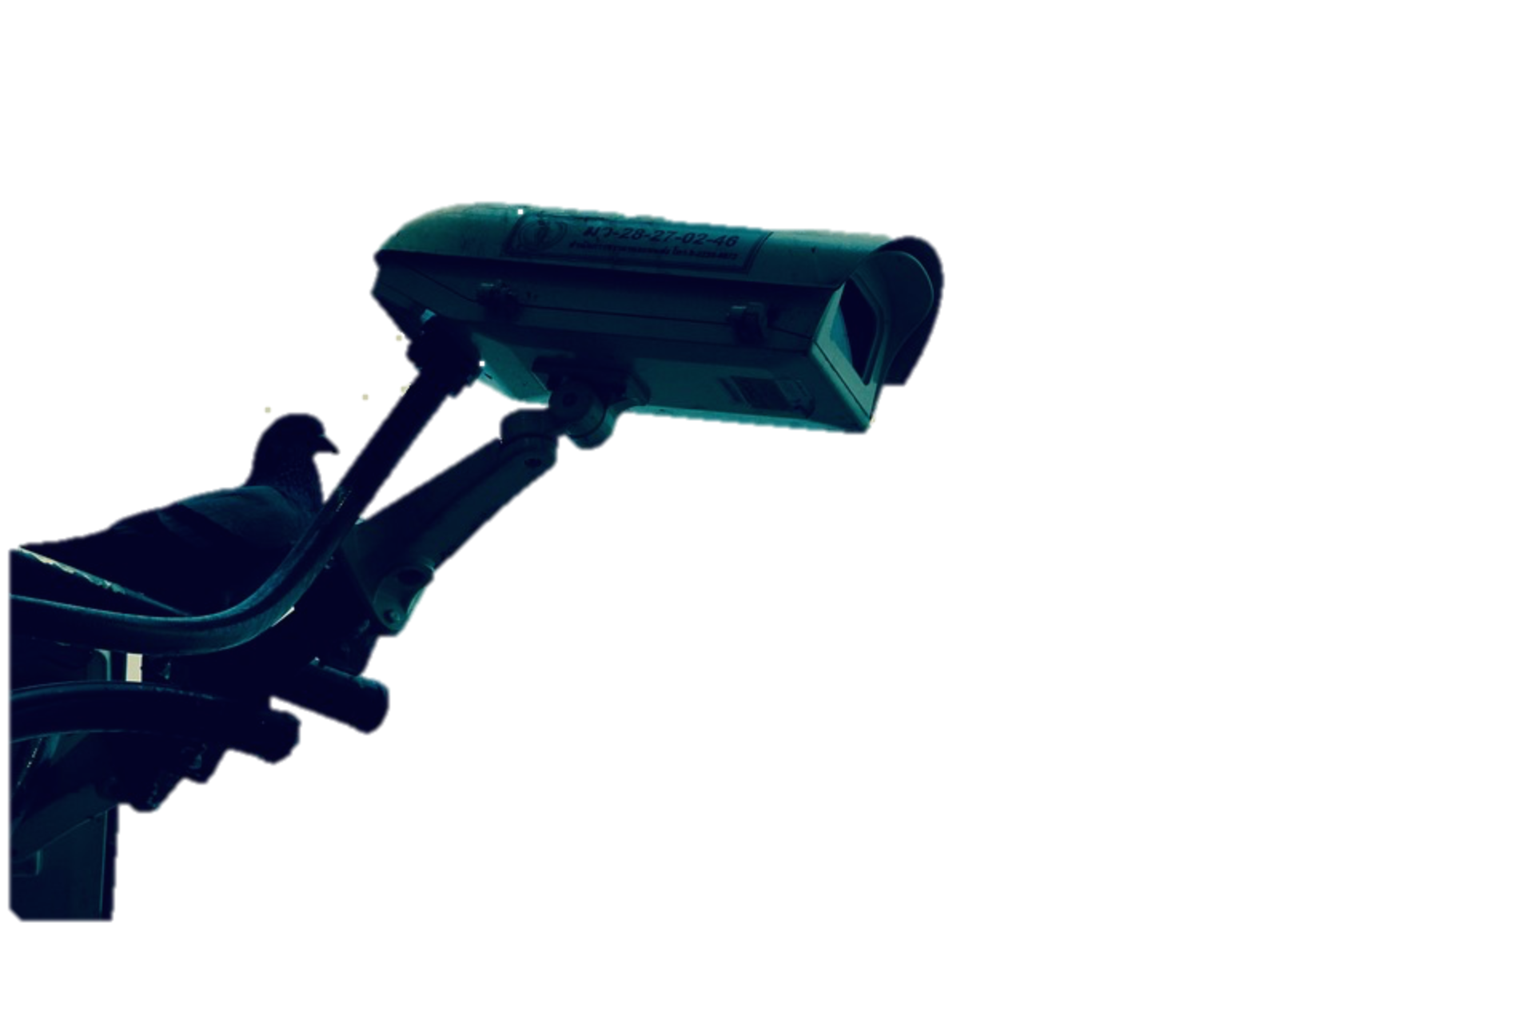
BACKGROUND
After a crime, police may have to follow the path of the criminal.
Difficulties : Too many cameras
Low quality of videos
Identify an individual in a crowd

Slide 6
BACKGROUND
Expensive process requiring a great deal of human resources.
Solution:
Automating the face recognition process in surveillance video

Slide 7
Problem Statement
Best results in face recognition with deep learning.
FaceNet (2015) reaches a 99.63% accuracy on“LFW” dataset for identification.
Goal: to build a deep neural network for face recognition on surveillance videos. Model based on the latest deep learning algorithms

Slide 8
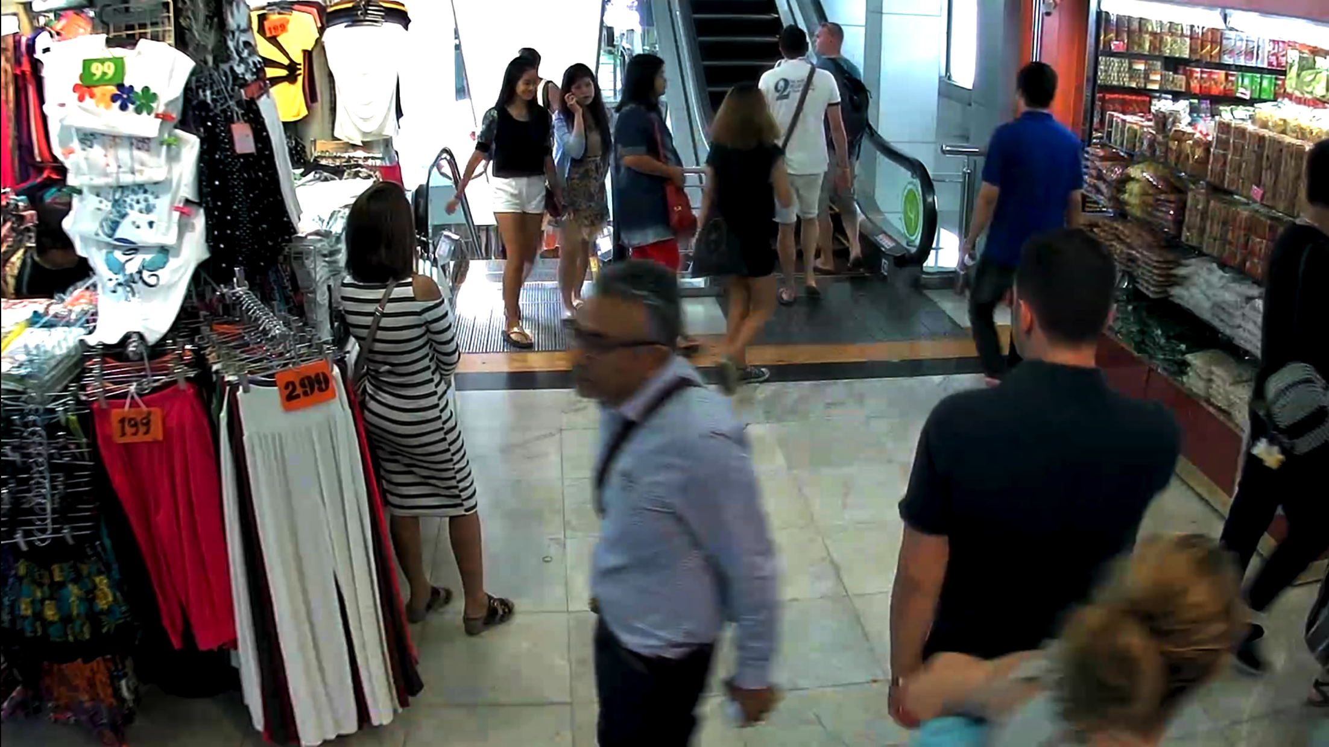
Objectives
A database contains recorded videos from the surveillance camera network at the MBK shopping mall in Bangkok.
Notes:
----- Notes de la réunion (3/21/16 07:56) -----
Database already provided.
Contains recorded videos from surveillance camera network at the MBK shopping mall in Bangkok.

Slide 9
Literature Review

Slide 10

Deep Learning
In « Deep learning methods and Applications »: « Deep learning is a set of algorithms in machine learning that attempt to learn in multiple levels, corresponding to different levels of abstraction. It typically uses artificial neural networks. »
Representation extracted from cs231n.gitub.io

Slide 11
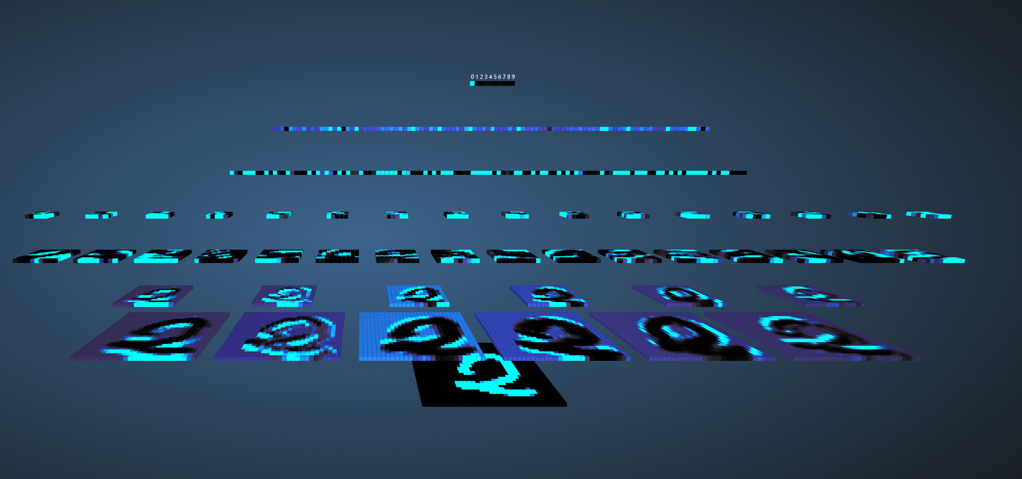
Convolutional Networks
Connect only adjacent neurons of a layer to the next one, whereas, standard layers connect all the neurons of a layer to the next one.
A subsampling of the convolutional layer is applied
Finally, generally, standard fully-connected layers.
Notes:
----- Notes de la réunion (3/21/16 08:06) -----
Don't go too much in the details here because the next slides do this job.

Slide 12
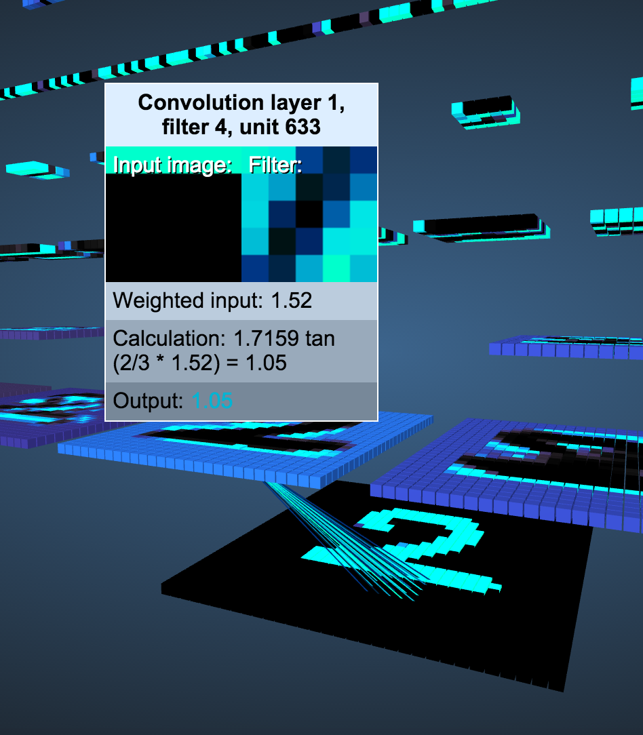
Convolutional Networks
Connect only adjacent neurons of a layer to the next one, whereas, standard layers connect all the neurons of a layer to the next one.

Slide 13
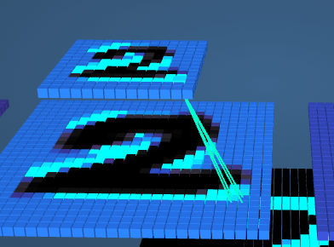
Convolutional Networks
Then, a subsampling of the convolutional layer is applied .

Slide 14
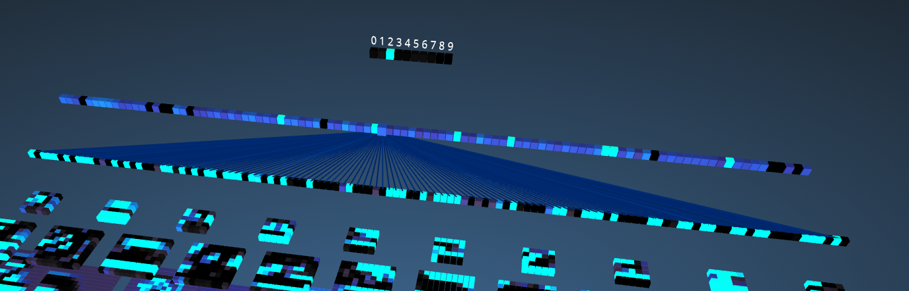
Convolutional Networks
Finally, standard fully-connected layers are applied.

Slide 15
DL for face recognition: Two main methodologies
Recognition by person identification. A network takes an image as an input and returns a label that identifies one and only one person as an output.
Recognition by comparison. A network takes a pair of images as an input and “1” if they represent the same object — in our case, the face of a person — and “0” otherwise.

Slide 16
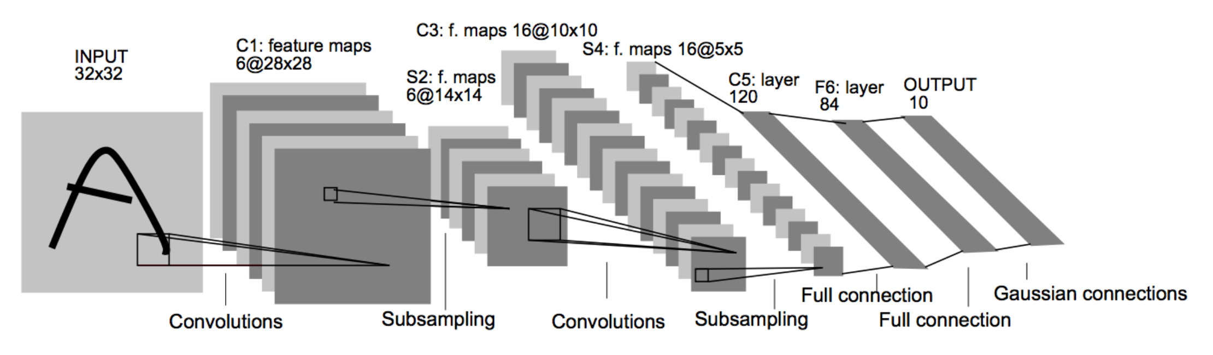
Recognition by person identification

Slide 17
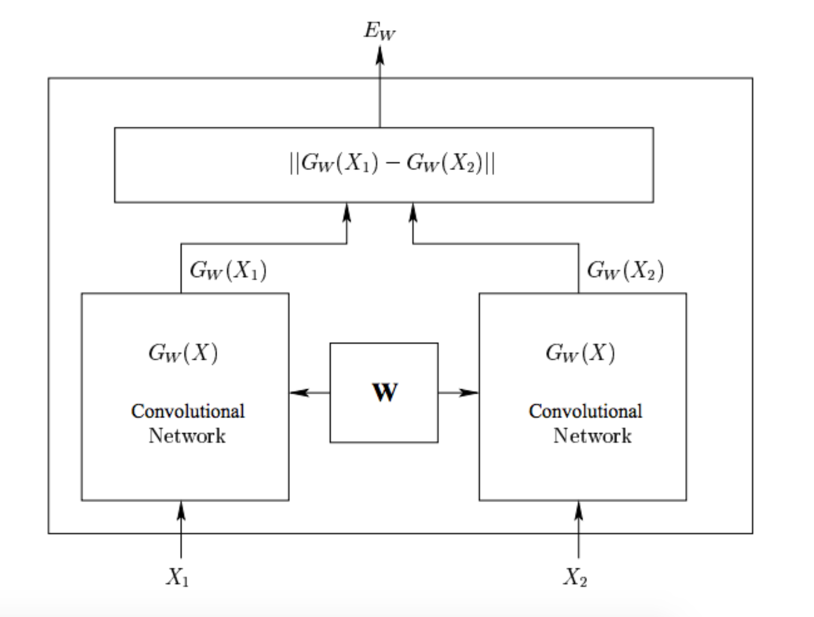
Recognition by comparison

Slide 18
Methodology

Slide 19
Design of the final product

Slide 20
Solution Design

Slide 21
Database
The database that will be used for the learning process is a set of 14 videos recorded in the MBK Shopping Center of Bangkok.
Duration of the videos is variable, from a minute to around 3 minutes and 30 seconds.
Three of the researchers of our laboratory appear in the videos, walking in the mall like any other person.

Slide 22
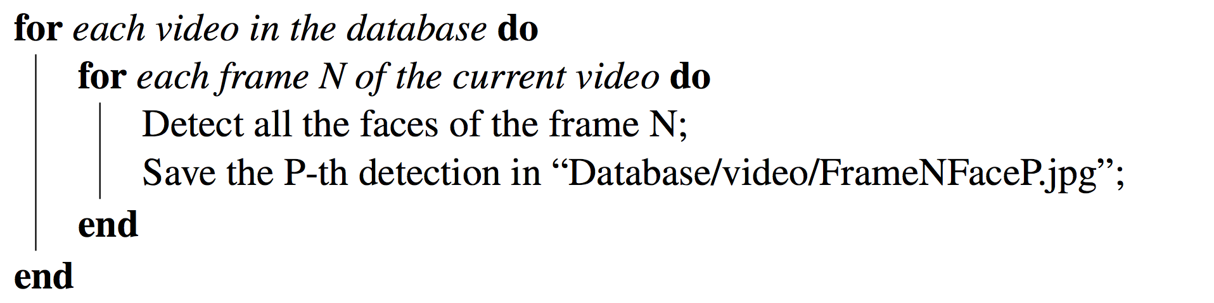
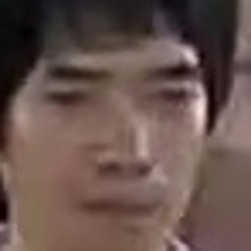
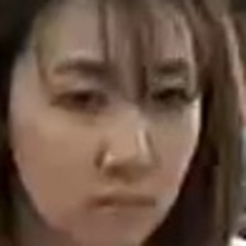
Raw Database of faces

Slide 23
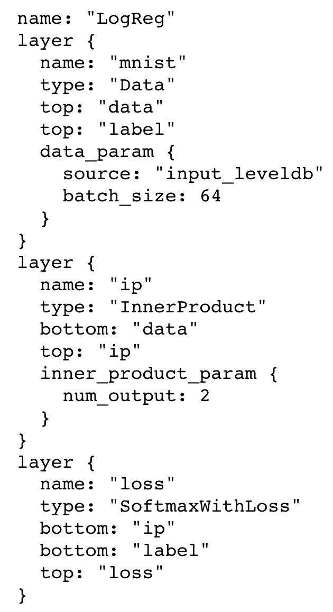
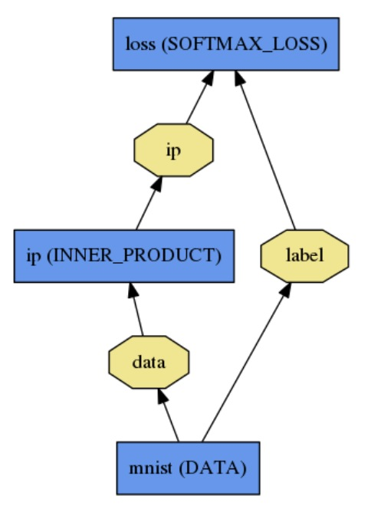
Caffe

Slide 24
Models
Two models in particular will be studied.
Direct face identification.
Identification by comparison

Slide 25
Training and Testing files
Structure of train.txt and test.txt:
/adress/of/the/training/image1.jpg label1 /adress/of/the/training/image2.jpg label2 ... /adress/of/the/training/imageN.jpg labelN
Particular case of comparison networks. Need two files train1.txt and train2.txt

Slide 26
Output & Testing
Person identification: The output is a label. Accurracy is easy to compute.
Identification by comparison: The output is an energy.
High for two images representing two different people and low otherwise.
A threshold on this energy has to be determined to make classification possible with the network.
Then a script will be written with pycaffe to compute the accurracy.

Slide 27
Preliminary Results

Slide 28
Solution Design -Most scripts are written -A siamese model is already trained

Slide 29
Thanks for your time!

